Slide 1


Slide 2
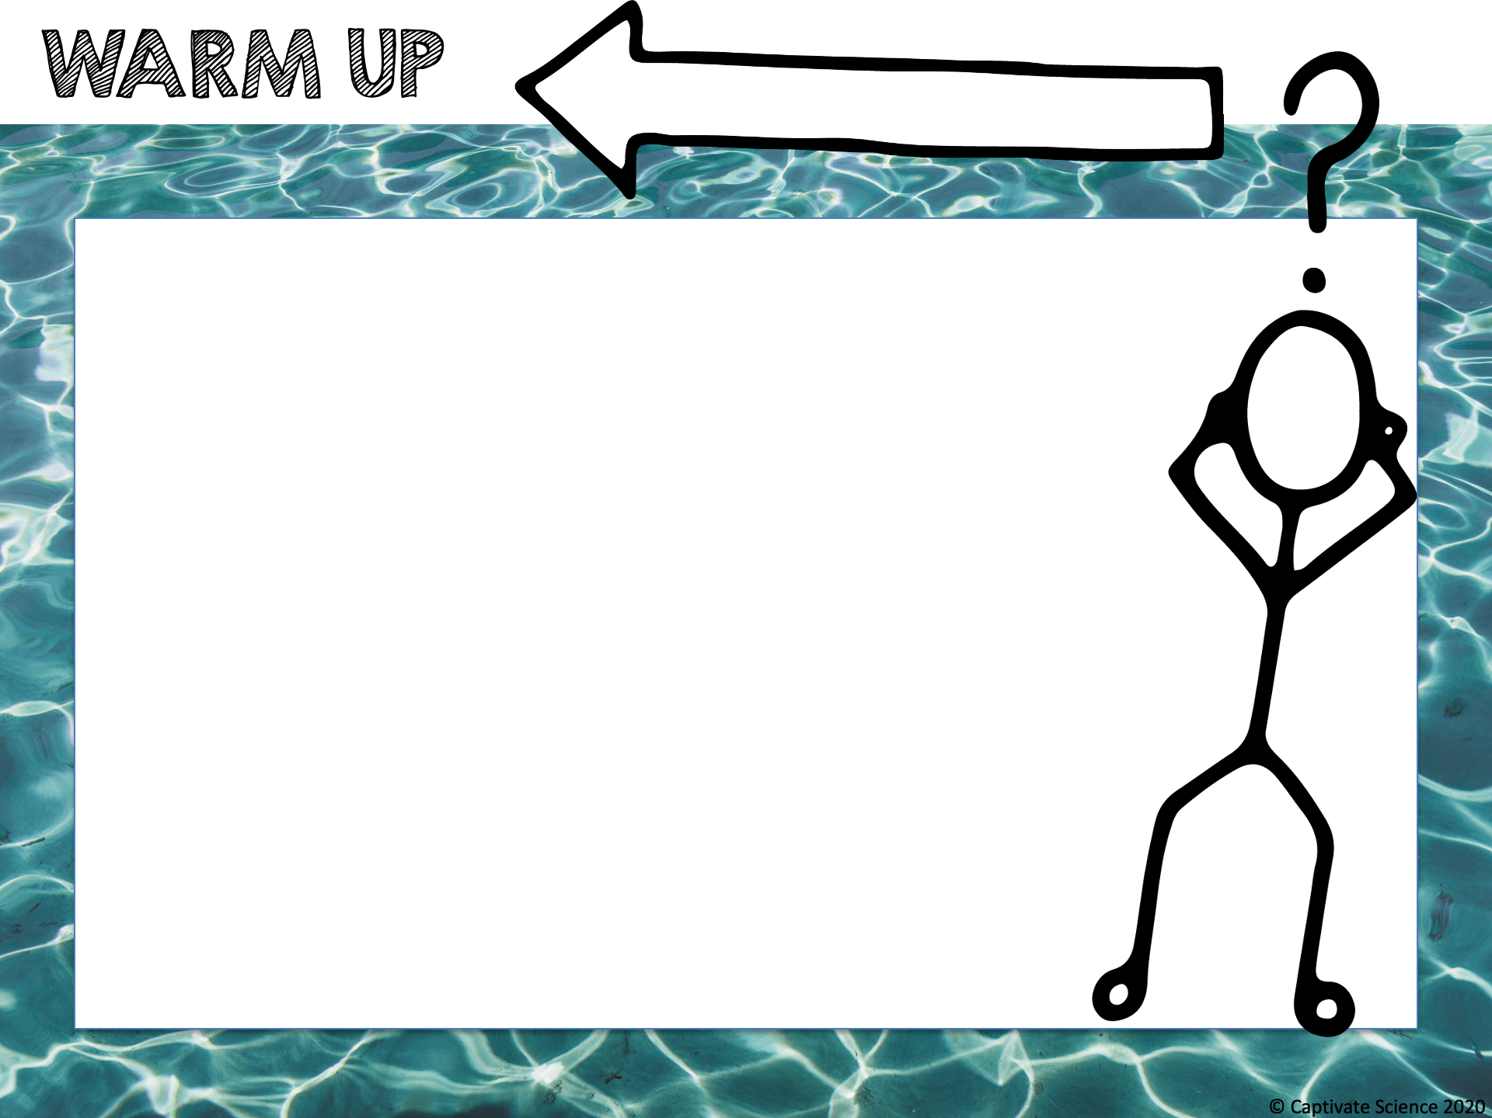
The pH of a solution is a measure of the concentration of hydrogen ions in the solution.
Chlorine is used to sanitize pools and keep them safe for swimming.
Chlorine works best to disinfect a pool only when the pool water has the correct pH.
Do you think pools need a high pH (basic), low pH (acidic) or neutral pH to be suitable for swimming?

Slide 3
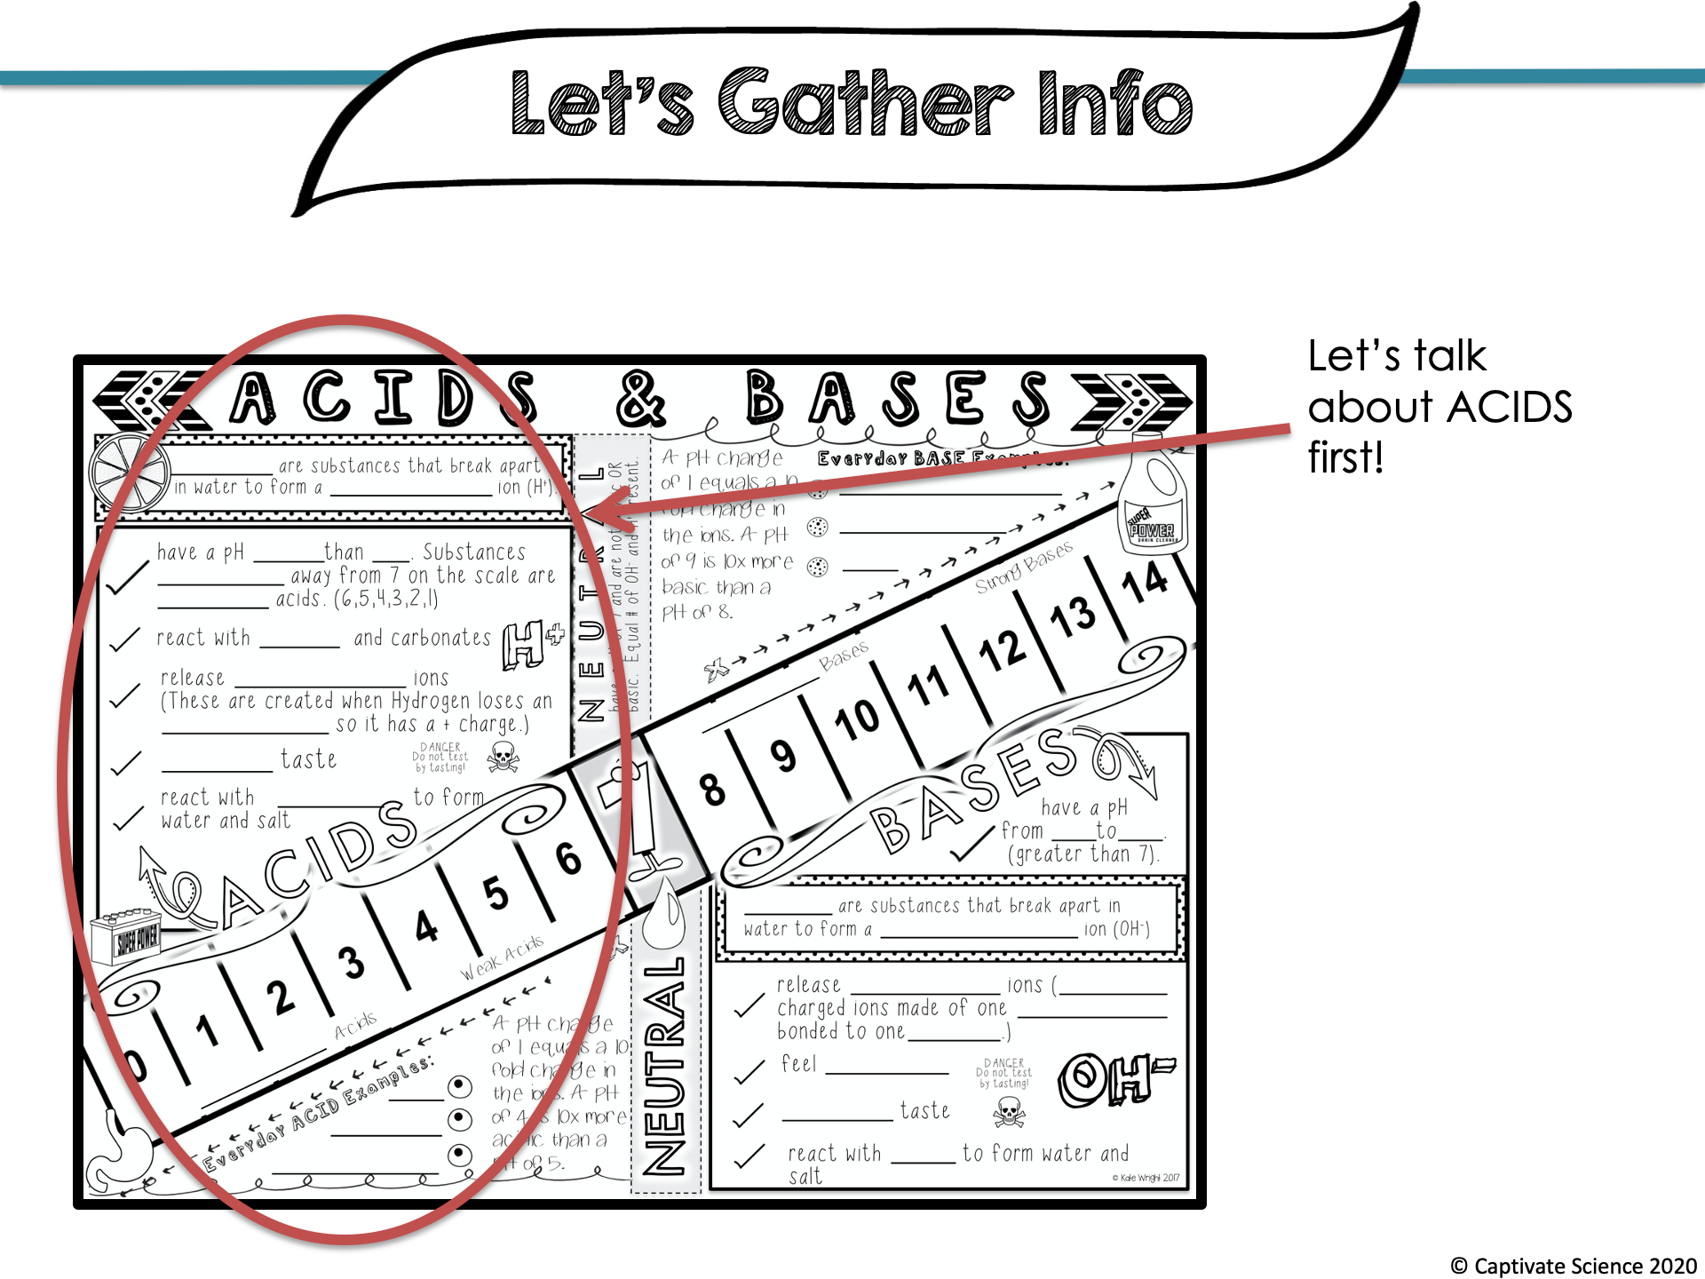

Slide 4
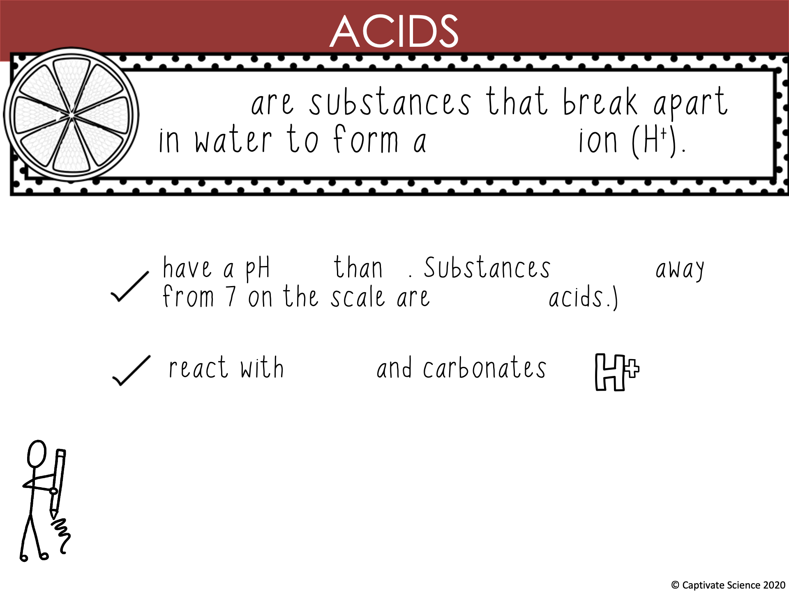
Acids
hydrogen
less 7 farther
stronger
metal

Slide 5
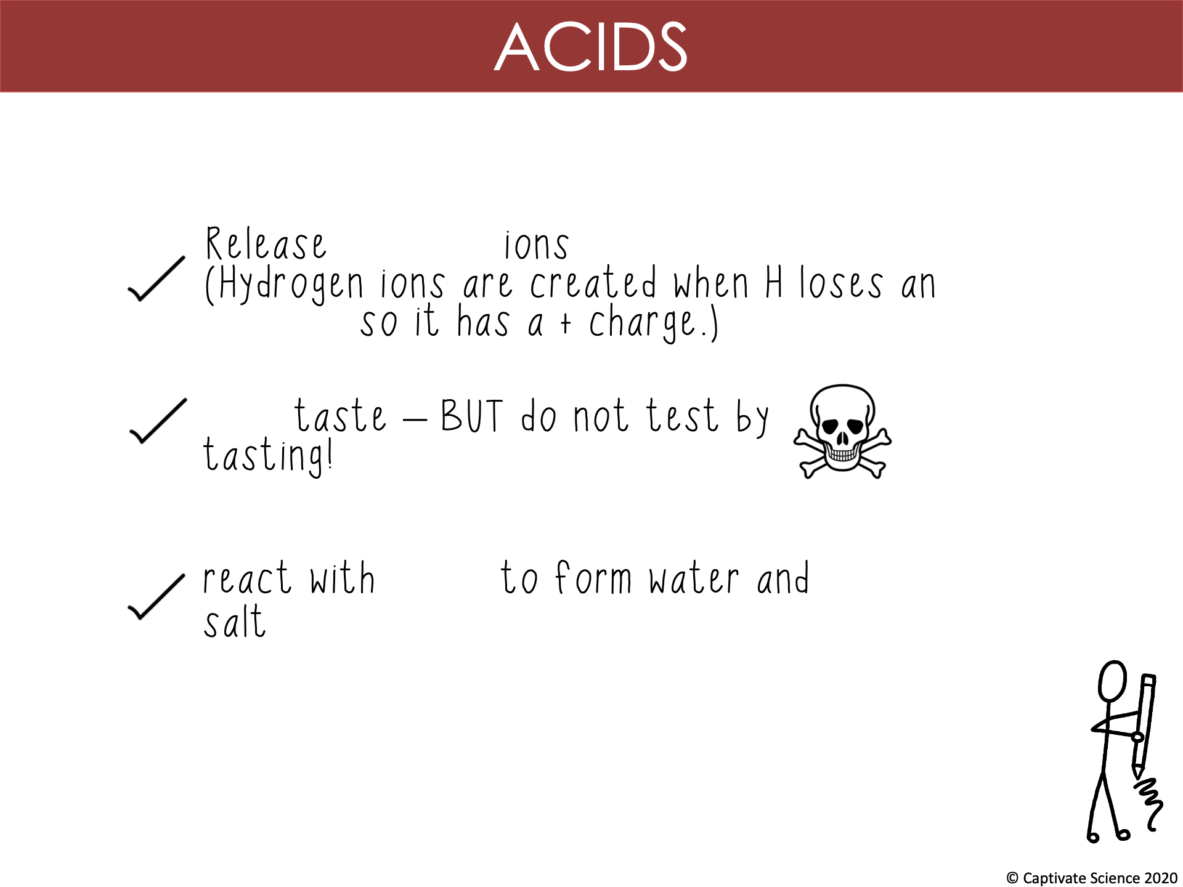
hydrogen
electron
sour
bases

Slide 6
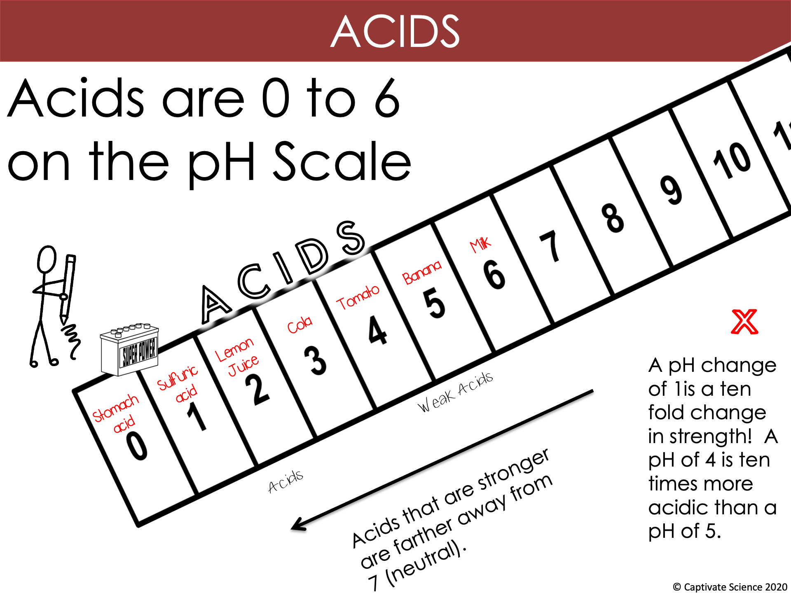
10
STRONG

Slide 7
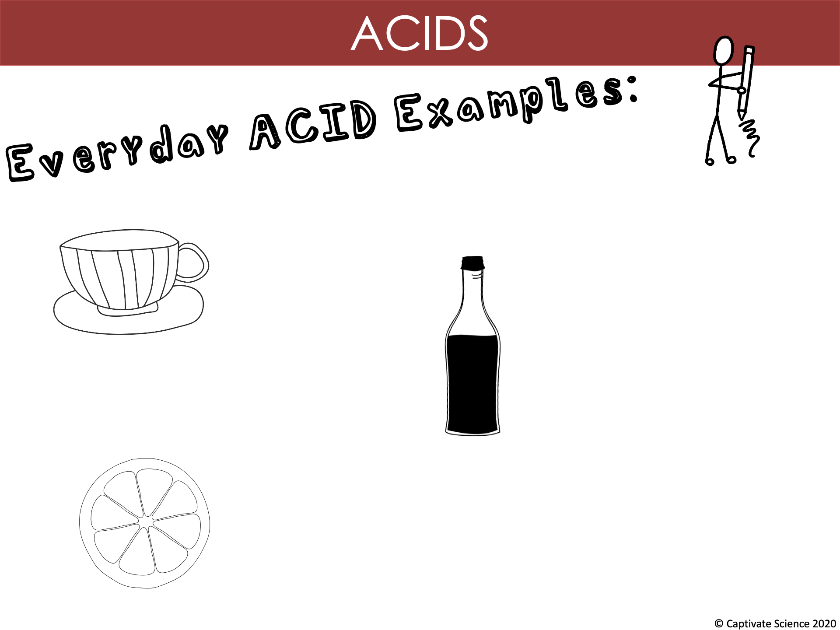
Tea
Vinegar
Citrus Fruit

Slide 8
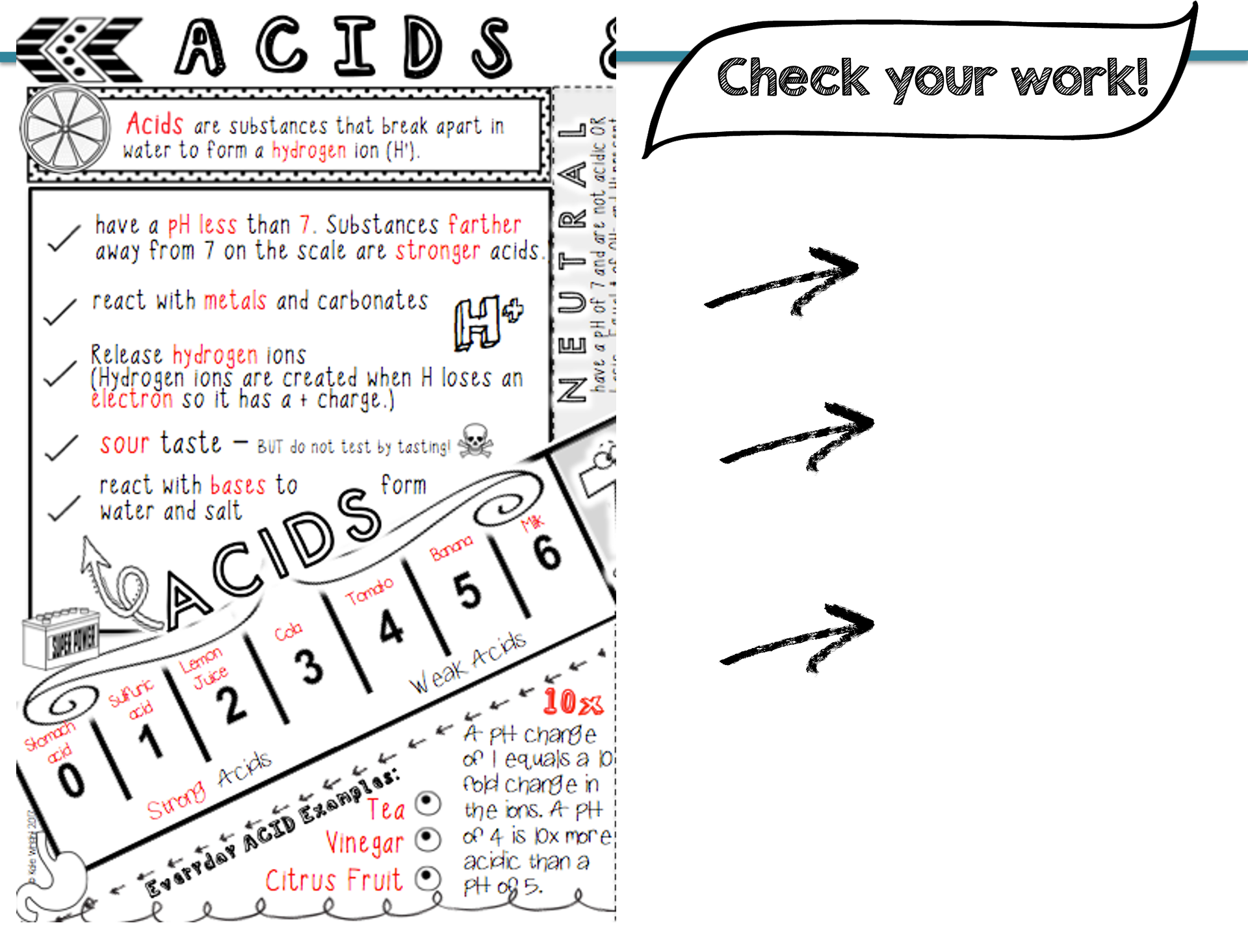
Do you have all the key information? (red)
How do you visualize adding color to emphasize the most important parts?
What facts seem to be easy to remember? What seems more challenging?

Slide 9
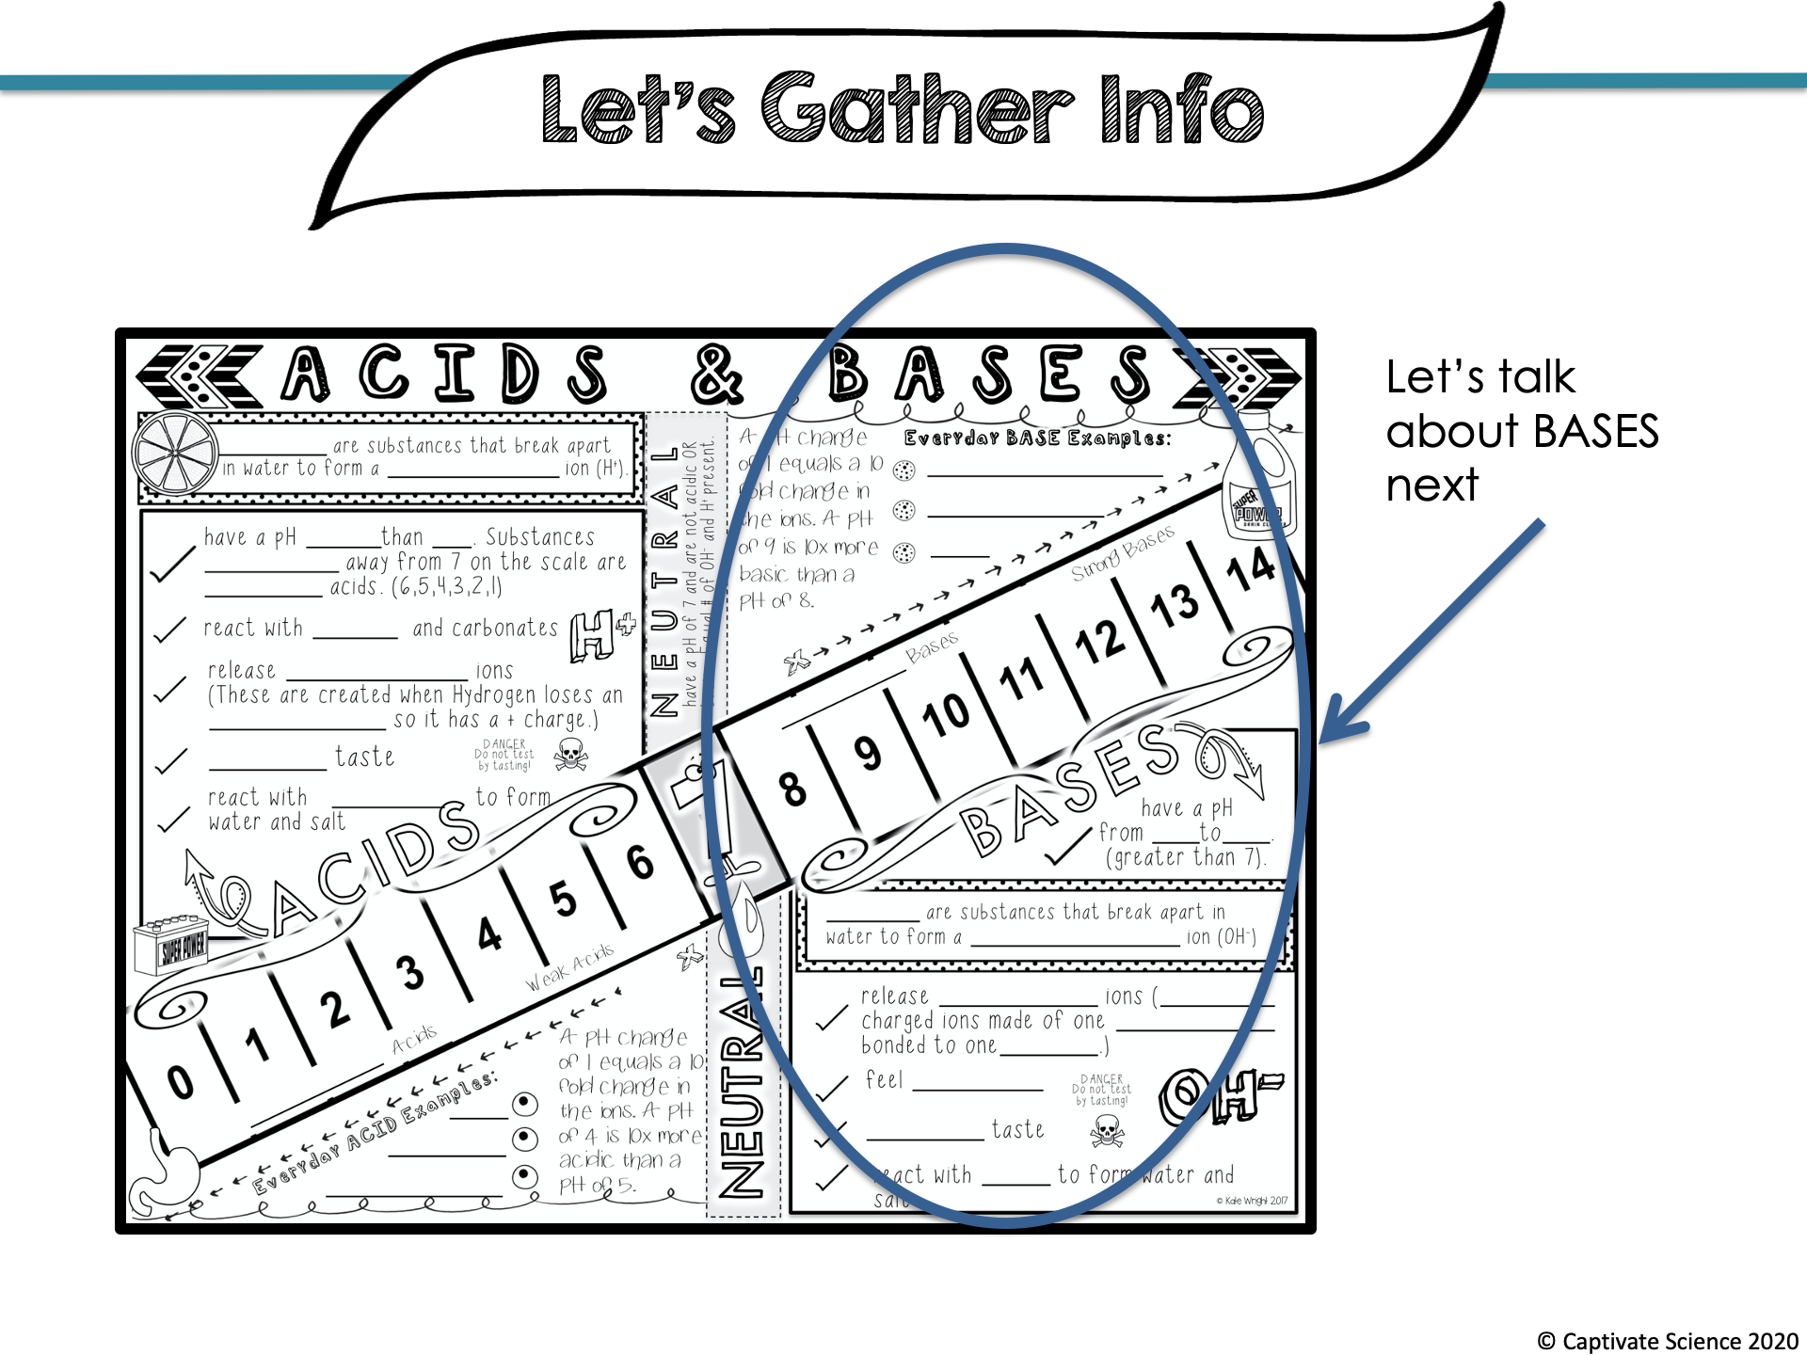

Slide 10
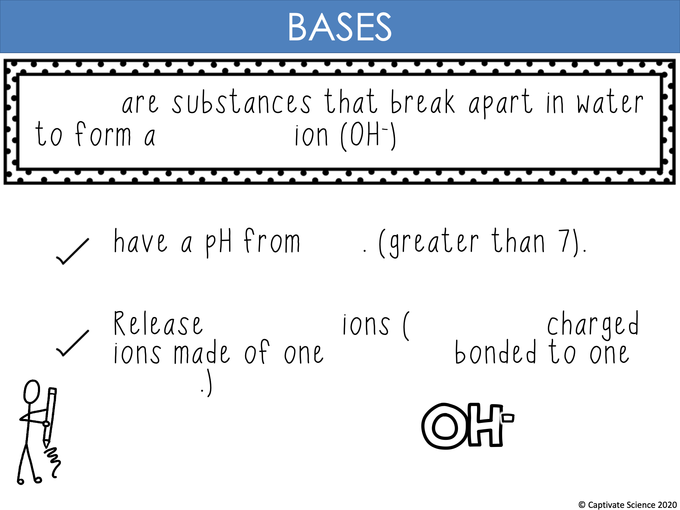
Bases
hydroxide
8-14
hydroxide
negatively
hydrogen
oxygen

Slide 11
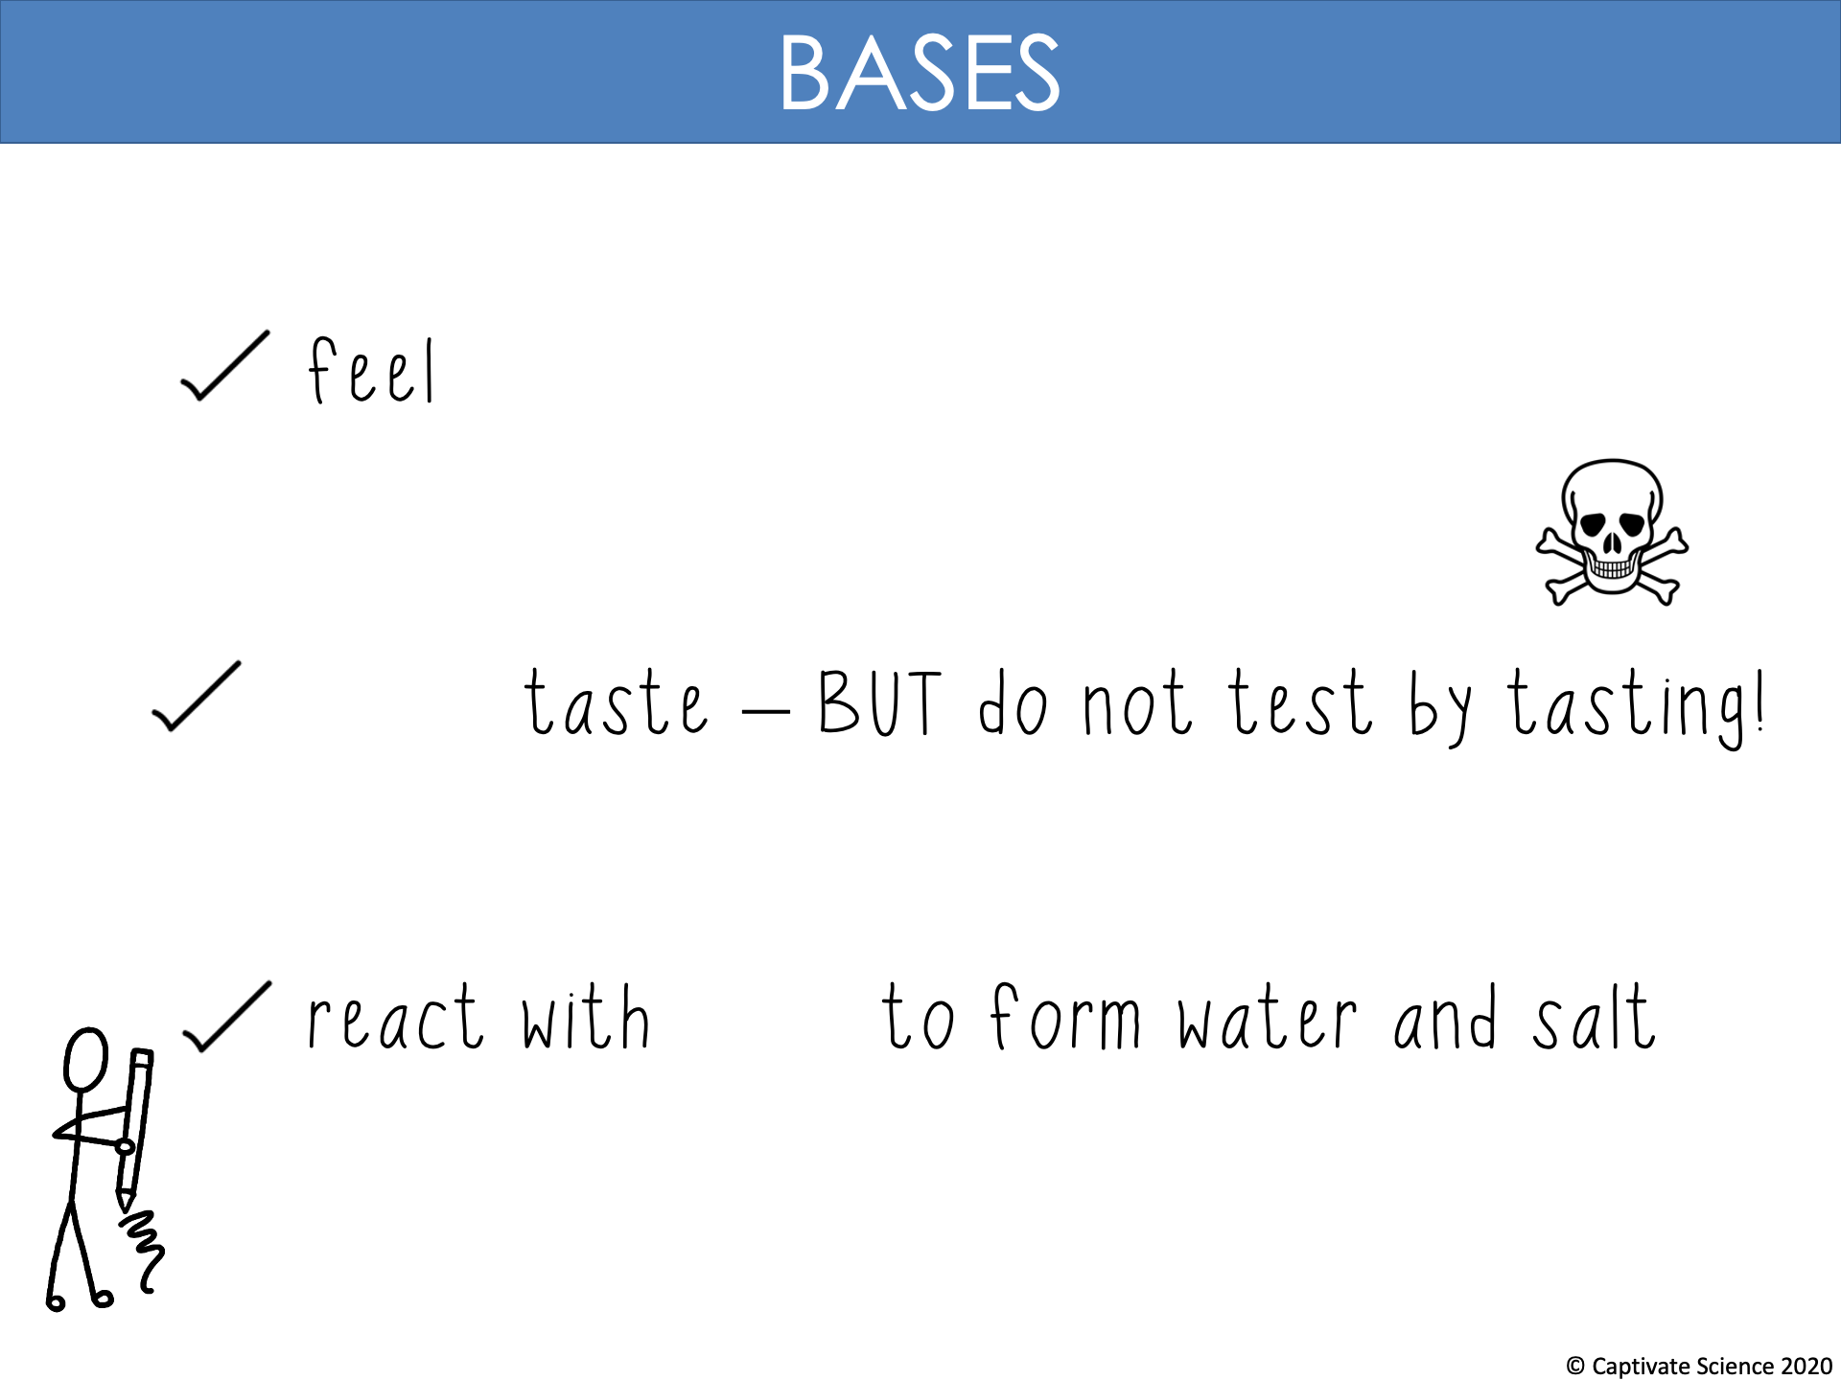
slippery
bitter
acids

Slide 12
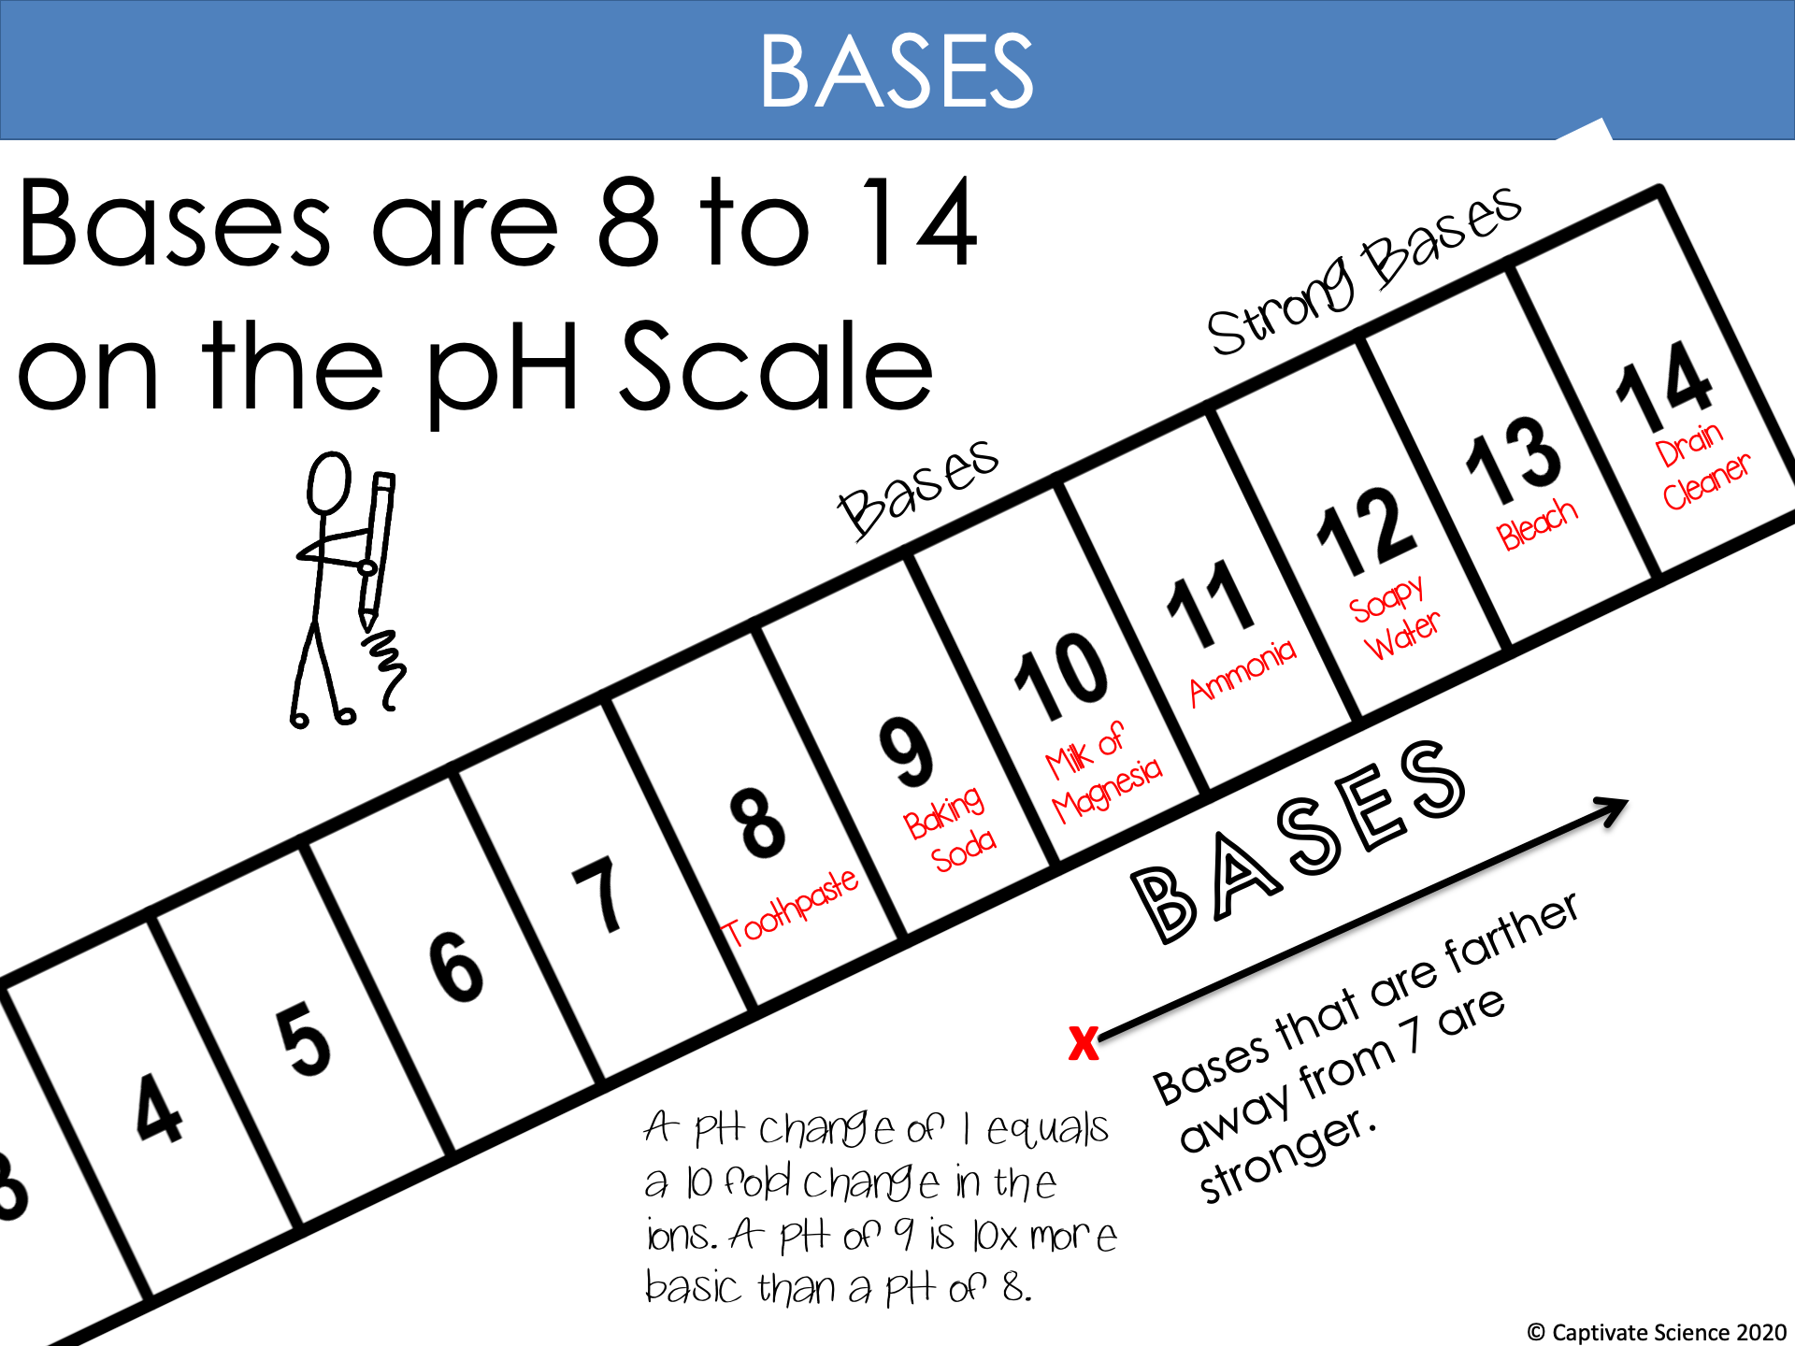
Weak Bases
10x

Slide 13
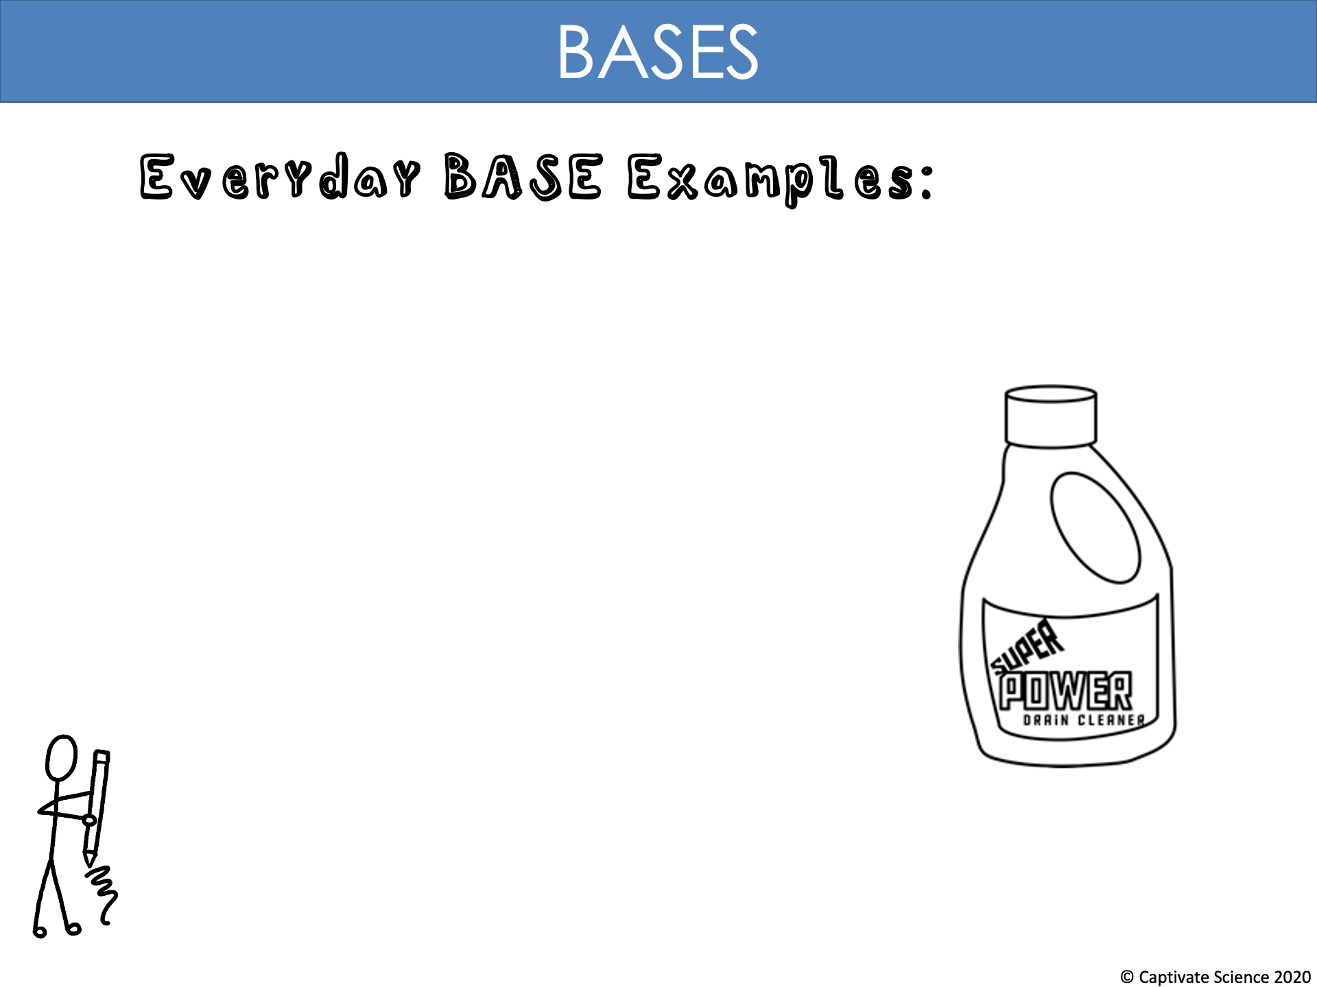
Baking Soda
Bleach
Soap

Slide 14
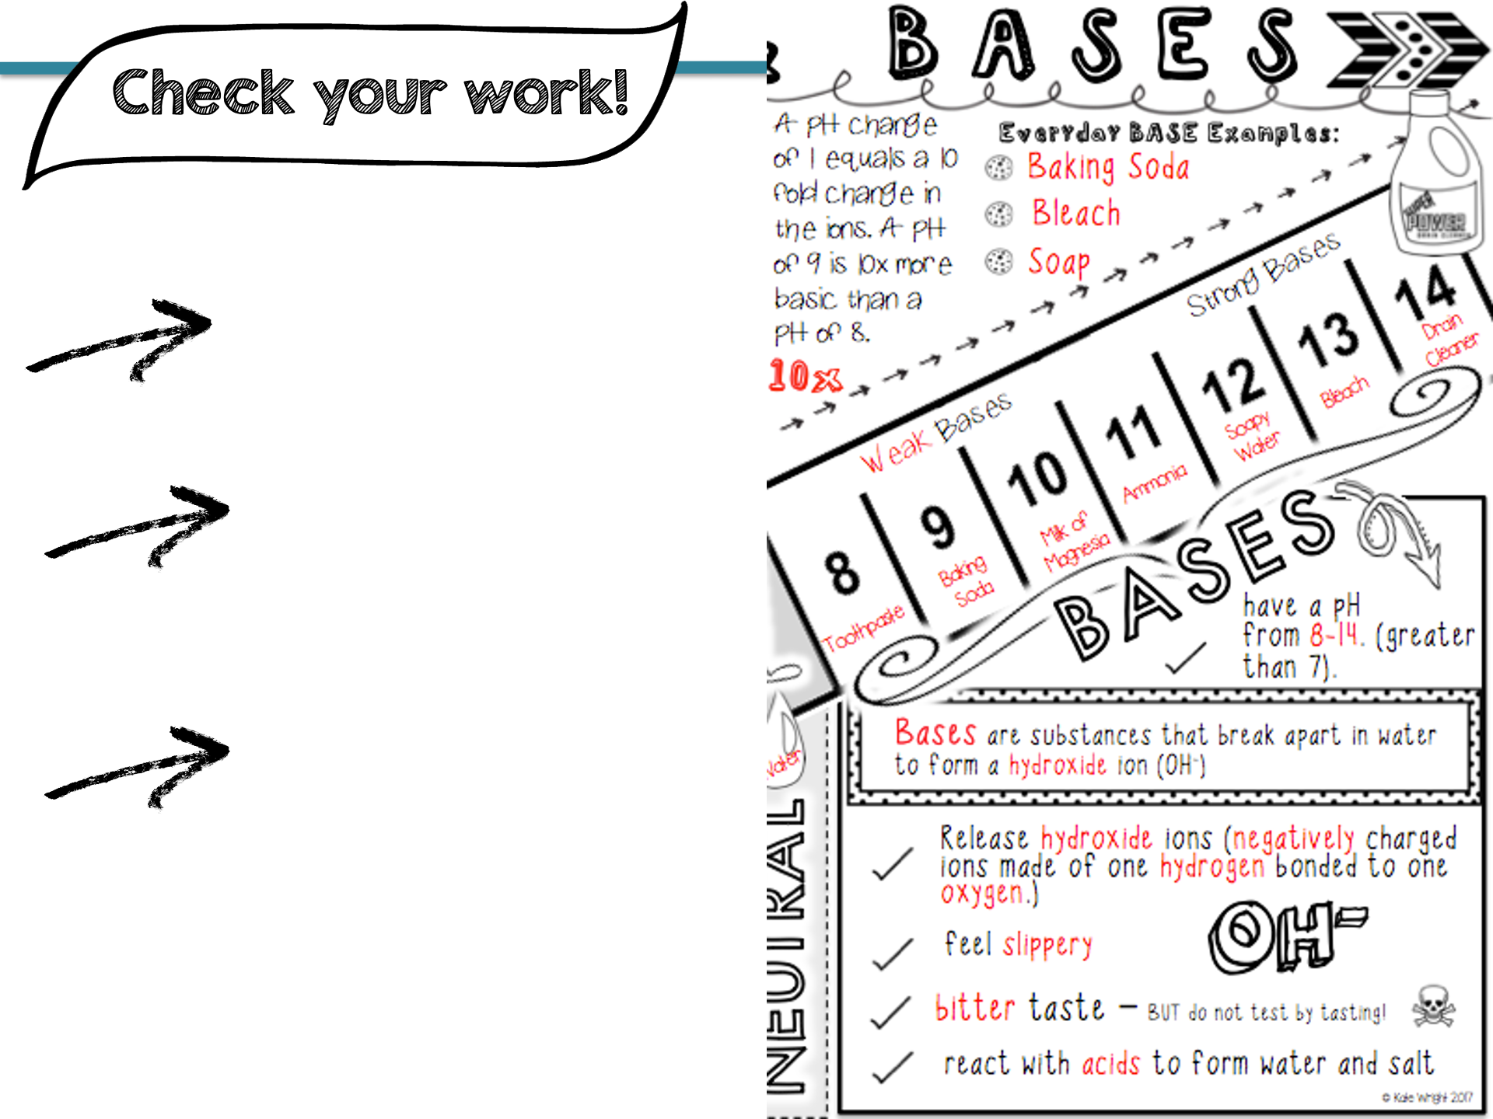
Do you have all the key information? (red)
How do you visualize adding color to emphasize the most important parts?
What facts seem to be easy to remember? What seems more challenging?

Slide 15
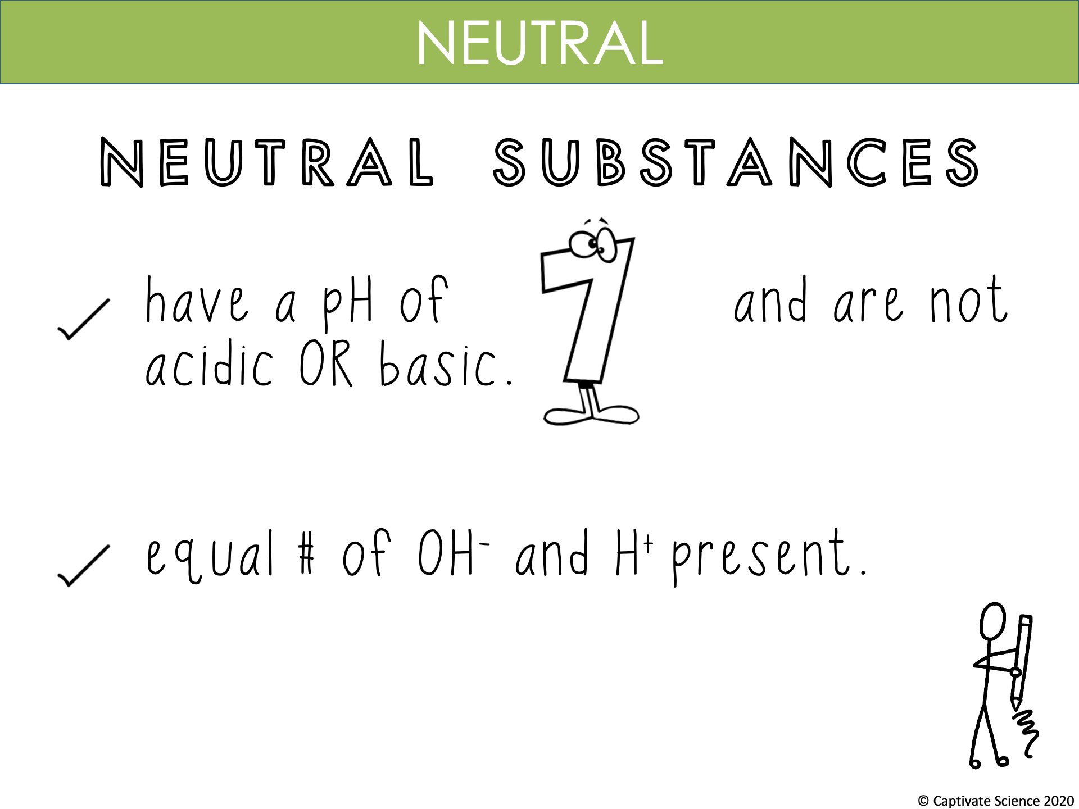

Slide 16
